Slide 1
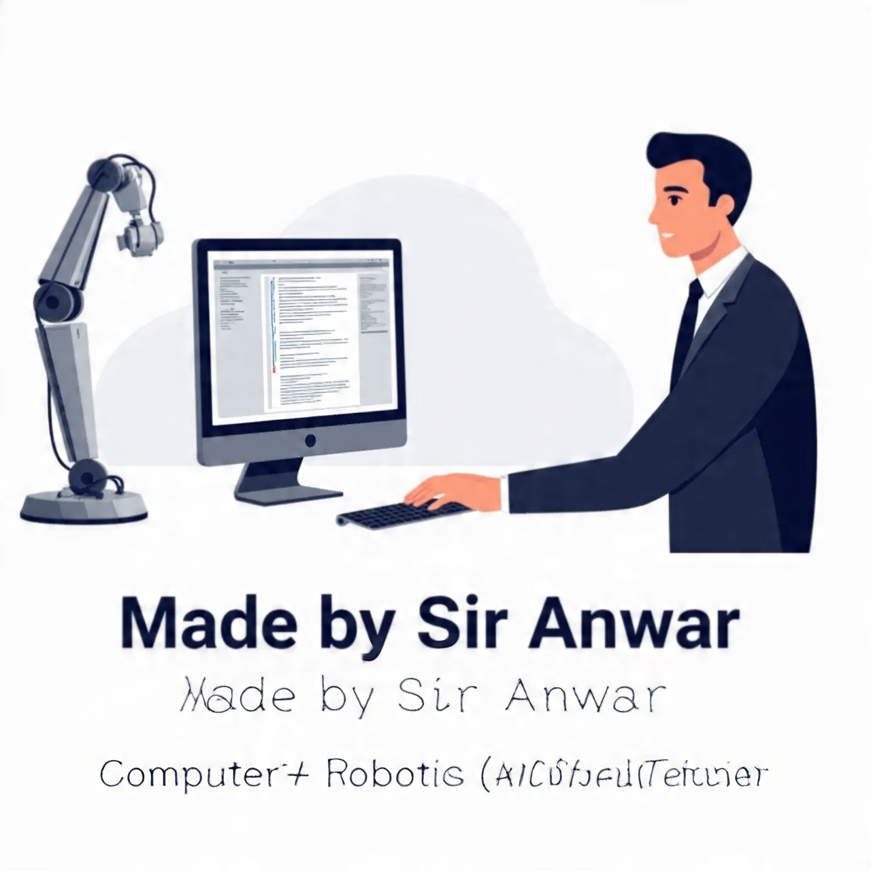

Slide 2
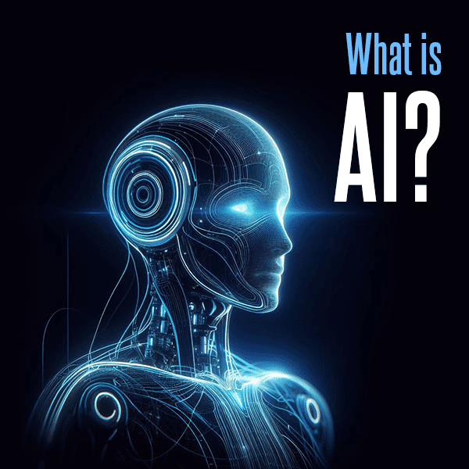

Slide 3
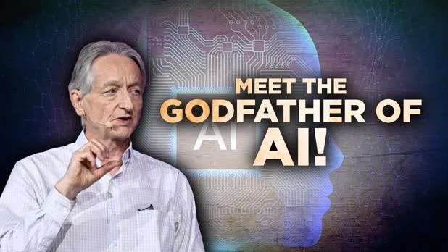
Geoffrey Hinton
He has been awarded the 2024 Nobel Prize in physics by the Royal Swedish Academy of Sciences. This article explores Hinton’s groundbreaking work, his journey to the Nobel Prize, and how his research has transformed the world of technology.

Slide 4
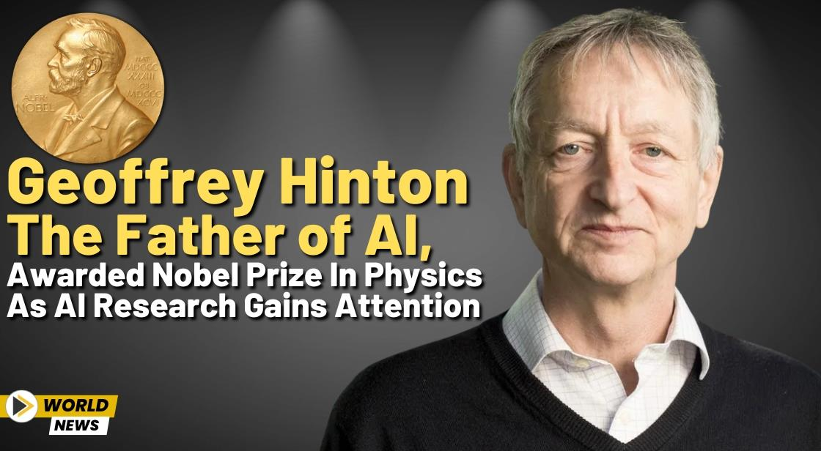
In a monumental moment for the world of Artificial Intelligence (AI), Geoffrey Hinton, known as the “Godfather of AI,” has been awarded the Nobel Prize for his pioneering work in neural networks and deep learning.

Slide 5
What is a neural network?
A neural network is a machine learning program, or model, that makes decisions in a manner similar to the human brain, by using processes that mimic the way biological neurons work together to identify phenomena, weigh options and arrive at conclusions.
A biological neural network in the human brain is a complex system of billions of interconnected nerve cells (neurons) that process information by sending and receiving electrochemical signals through synapses

Slide 6
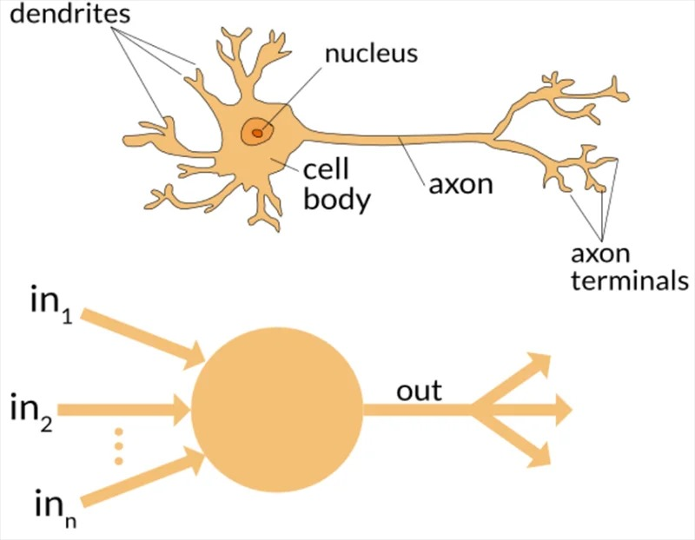

Slide 7
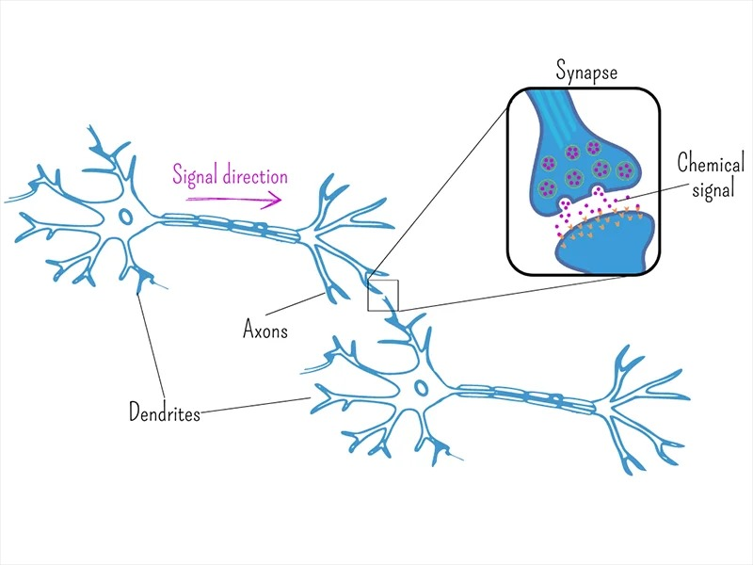
Dendrites
Receive messages (chemical signals) from other neurons.
Axons
Transmit signals to other neurons, muscles, or glands.
Synapse (illustrated in the inset)
The junction between the axon terminal of one neuron and the dendrite (or cell body) of the next neuron.

Slide 8
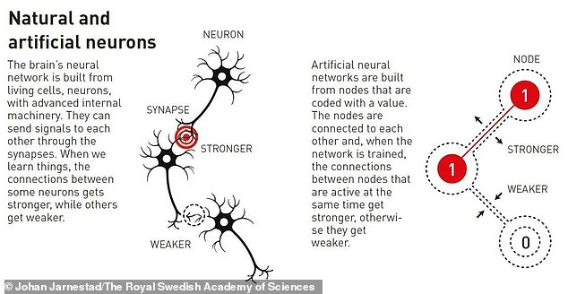

Slide 9
What is AI (Artificial Intelligence)?
In simple terms, Artificial Intelligence refers to the ability of a computer or machine to think and learn like a human. Just like humans learn from experience and improve over time, AI systems are designed to learn from data and get better at tasks without being explicitly programmed for every situation.
Imagine you’re teaching a child to recognize animals. You show them pictures of cats, dogs, and birds, and after a while, they learn to identify them on their own. AI works similarly by "learning" from the data it’s given and then making decisions or predictions based on that information

Slide 10
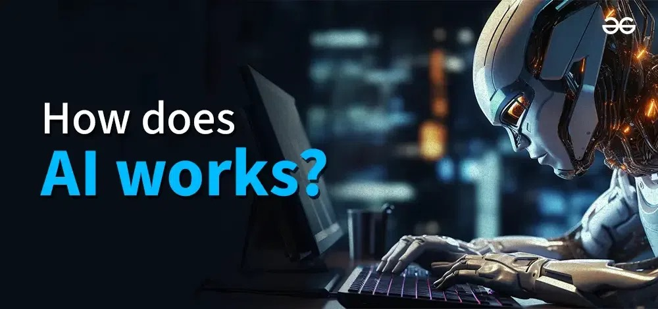
Data → Information Meaning: Raw facts, numbers, or details we collect.
Model → Representation Meaning: A system or structure that shows how something works.
Train → Learning Meaning: The process where a model studies data to improve itself.
Test → Evaluation Meaning: Checking how well the model has learned by using new data.

Slide 11
